Slide 1

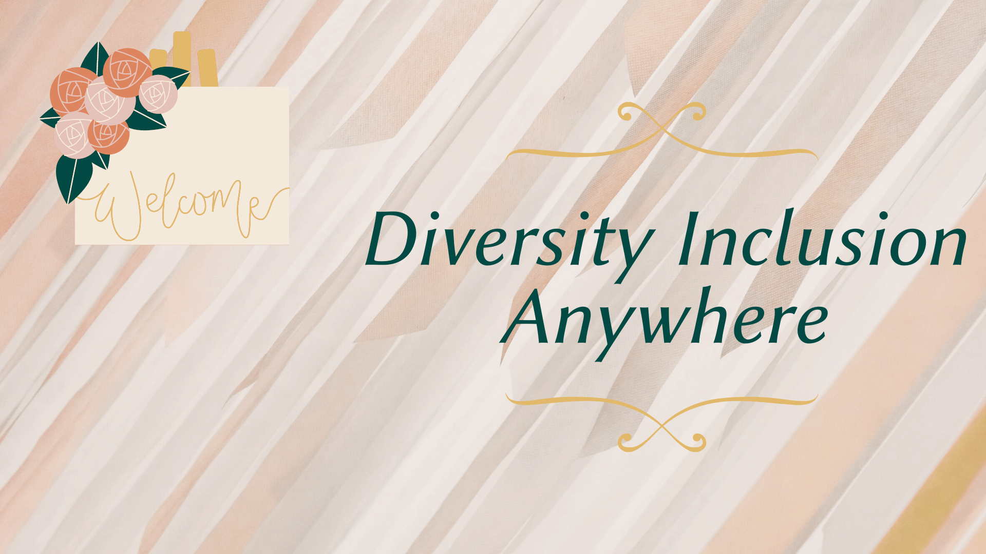

Slide 2

01
The primary objective of the assistive technology that we have created is to make a meaningful impact on the community
PRIMARY OBJ ECTIVE
02
We are driven by causes that allow us to turn to technology to solve the community’s major issues and provide the stakeholders with added value.
03
We strive to deliver inclusive solutions through accessible technology that addresses the needs of people with disabilities to enable them to be self-sufficient.
04
Accessibility and equitability of technology will ensure diversity as well as creativity in the community which drives innovations.

Slide 3
CORE VALUES
ACCESSIBILITY
ACCEPTABILITY
AFFORDABILITY
ADAPTABILITY

Slide 4

About Our Product
Value Proposition
Value Proposition
increase your comfort, confidence, and competence
Core functions:
hearing/vision impairment → focusing on language and communication (deaf: speech-to-text, visually impaired: text-to-speech) → high accessibility
Accessibility
Technology
Accessibility
Core technologies integrated into the project: Microsoft Azure Cloud Application, and Flutter UI software development.
Technology

Slide 5
About Our Product (cont.)
Our project is capable of incorporating Machine Learning API to generate a feed for active users based on the large sample of data collected from the questionnaires that surveyed people with disabilities.
We proactively ideate, build, and develop the model which maximizes the scale of impacts.
While we developed the project, we integrated both qualitative/quantitative resources to enable the final model to be more inclusive and well-thought-out.
We believe that “empathy” was the first step that we took an initiative with in order to create an excellent education model.
We are also confident that our model is also a minimum viable product that delivers great accessibility to users.

Slide 6
Accessible & Impactful Algorithm

Slide 7
Any Questions?
Please let us know!
Nahom Berhe
Nahom7berhe@gmail.com
Lana Shin
Shjllana59@gmail.com

Slide 8

Thank you for your attention!
Diversity and inclusion, which are the real grounds for creativity, must remain at the center of what we do.
~ Marco Bizzarri

